Slide 1
Lecture 6a
More Decision Trees
Breitzman 7/23/2018

Slide 2
Last Lecture
Who remembers some things about decision trees?
  What are they good for?
  How do we prepare data for them?
  What are the names of the algorithms for making decision trees?
  What kinds of algorithms are they?

Slide 3
Last Lecture
What are they good for?
  Well, making decisions of course. Who might be a terrorist?, is she a bad credit risk?, might he get diabetes in the next year?, will she buy an iPhone in the next month? Etc.
How do we prepare data for them?
  Data has to be in categories. Continuous data has to be grouped.
What are the names of the algorithms for making decision trees? CART and C5
What kinds of algorithms are they? Greedy!

Slide 4
Last Lecture
We talked about decision tree shortcomings and advantages. Who remembers them?
Talked about the CART algorithm
This Lecture
More about CART
C4.5 Algorithm
Tree Pruning
Implementation in R

Slide 5
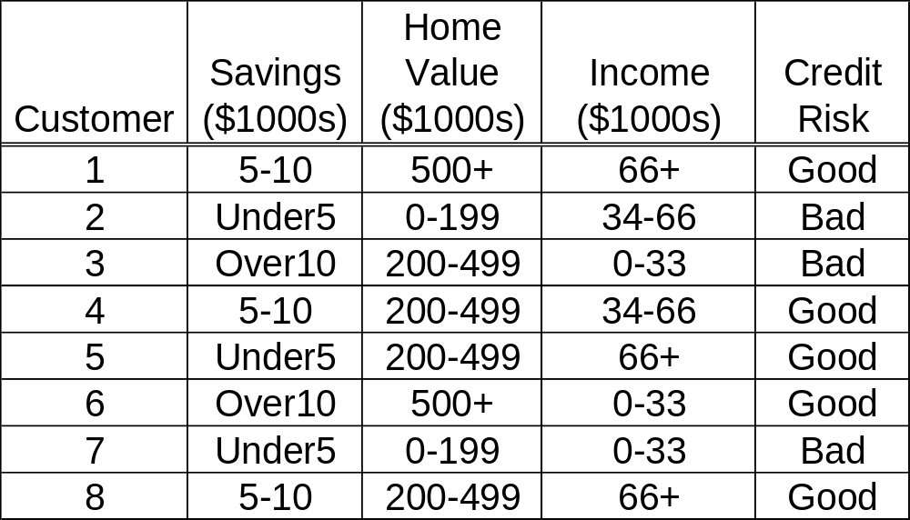
Recall Training Data from Last Week
(Continuous data converted already)

Slide 6
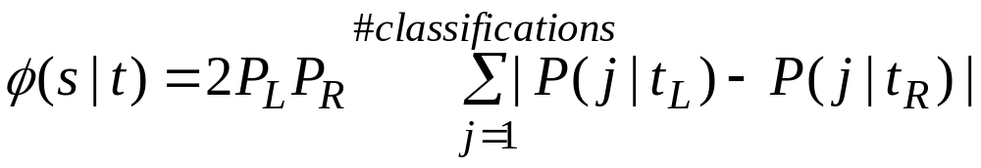
Recall CART
(Classification and Regression Trees)
Only makes binary trees
Every attribute will have a potential left and right child node
Greedy part is the split that maximizes the equation
Variable definitions on next slide

Slide 7
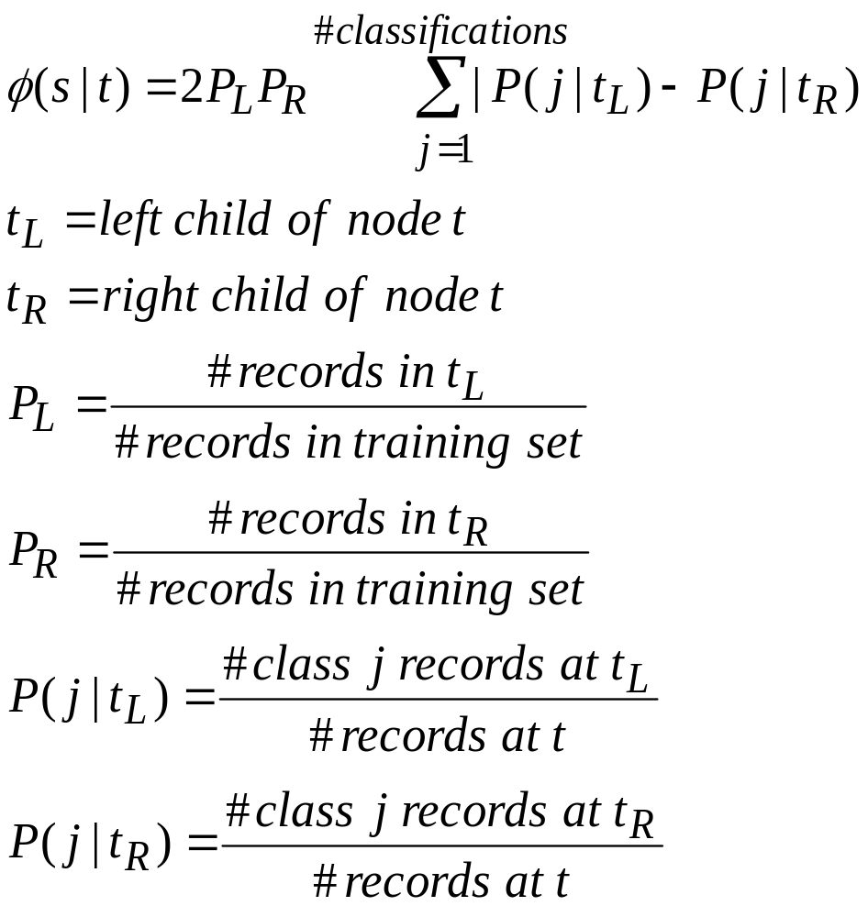
CART (II)

Slide 8
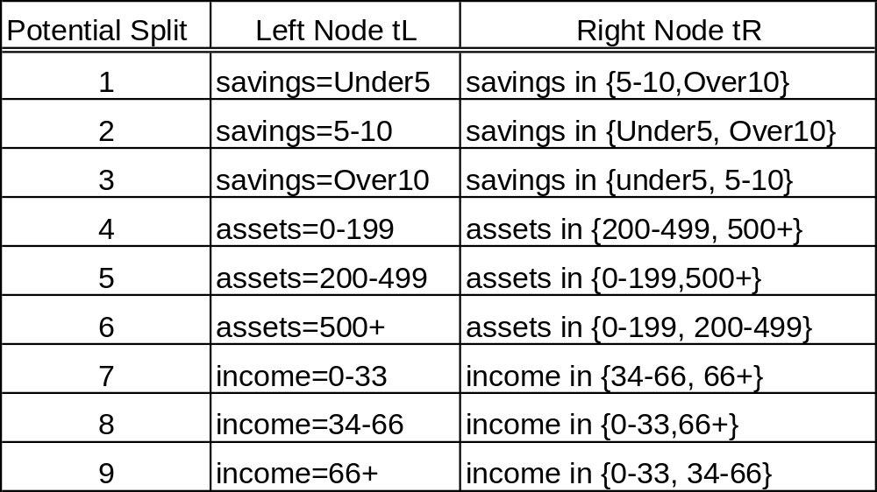

Potential Splits for t = root node
Now we just have to figure out which of these maximizes

Slide 9
Potential Split 1 Example
Left Child is Savings=Under5, Right Child is {5-10, Over10}
PL=(3 records with savings under5 / 8 examples total)=3/8
PR=(5 records with savings in {5-10,Over5}=5/8
P(j|TL) = 1/3 for good credit, 2/3 for bad credit
P(j|TR) = 4/5 for good credit, 1/5 for bad credit
2PLPR= 2(3/8)(5/8)
Sum=|1/3-4/5|+|2/3-1/5|
Φ(s|t)=2PLPR*Sum=(2(3/8)(5/8))*(|1/3-4/5|+|2/3-1/5|)
We compute φ for each of the 9 cases on the previous slide and choose the largest

Slide 10
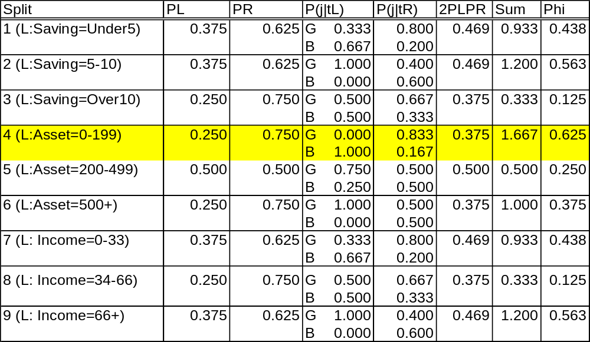
All Splits for Root Node
So the first split is on Assets (Home Value) 0-199. The example data records 2 and 7 go in left tree and become a node with target equal bad.
It then builds a new tree on the right based on example records 1, 3, 4, 5, 6, 8.

Slide 11
Excel
Go to Excel and show how previous slide was derived
Note we have to repeat all of the work for stage 2 using the remaining data.
  We can confirm this by showing the stage 2 result is not the second highest Phi from stage 1
Show stage 2 and stage 3
Pay particular attention to stage 3.
  Note we are keeping only the over 10 cases in stage 3. Why?

Slide 12
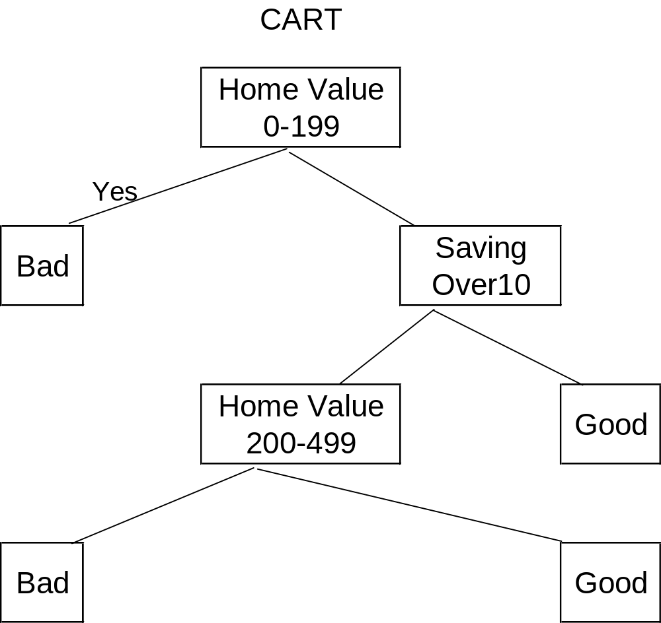
CART Tree Derived From Excel
Note someone with a house worth 200k-499k and over 10k in savings is a bad credit risk
This suggests building a decision tree with only 8 data points is not a great idea

Slide 13
Differences between C4.5 and CART
Recall the CART algorithm produced binary trees. C4.5 will have a branch for each category of an attribute. (e.g. Low, Medium, High will result in 3 branches)
This may result in a tree with more “bushiness” then desired if an attribute has a lot of categories
CART maximizes the differences between probabilities in a binary choice. C4.5 uses the idea of “information gain” or “entropy reduction” to make the best choice

Slide 14
Entropy in C4.5
Consider the result of a coin toss.
How many bits do I need to store that result?

Slide 15
Entropy in C4.5 (II)
If I store a head as 1 and tail as 0, I only need 1 bit to store a result.
If I’m trying to store N results I need N bits.
How many bits do I need to store something of probability of P? -Lg(P) of course! Clear as mud right?
Consider our coin toss. Pr(head) = ½. Note that
–Lg(1/2) = 1 so that’s 1 bit. -Lg(1/4) = 2 because it takes 2 bits to store HH which has probability ¼.
Does everybody remember their log rules? Can you confirm the math above?

Slide 16
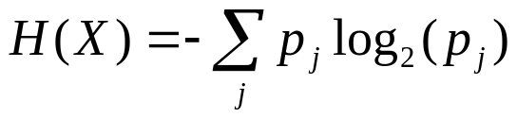
Entropy in C4.5 (III)
Suppose we have a target variable X whose k possible values have probabilities p1,p2,p3,…pk
What is the smallest number of bits required (on average) to store a stream of symbols representing the values of X?
The answer is called the Entropy of X and is defined as
Where does this come from? We saw the Log part on the previous slide. We multiply by each probability to get a weighted average for this mythical Entropy used in the algorithm

Slide 17
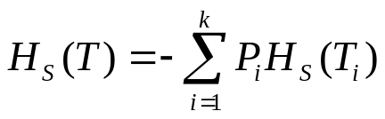
Information Gain in C4.5
Suppose we have a candidate split S that partitions the training data set T into subsets T1, T2, T3,..Tk. The mean information requirement can be calculated as the weighted sum of the entropies for the individual subsets
Where Pi represents the proportion of records in subset i
We then define “information gain” to be gain(S)=H(T)-HS(T), that is the gain is the decrease in entropy (randomness) from the previous state of the tree by making split S
Since C4.5 is a greedy algorithm we choose the split with the largest gain

Slide 18
Training Data from before

Slide 19
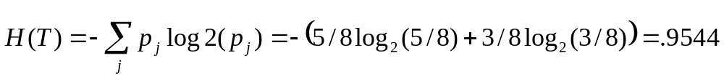
Entropies
Before any splitting we have 8 records with 5 classified as “good” credit risks and 3 as “bad” credit risks
We next compute entropy for savings noting that Punder5=3/8, P5-10=3/8 and Pover10=2/8
The under5 case has 1 record that is a good credit risk and 2 that are bad so the entropy is
–(1/3)log2(1/3)–(2/3)log2(2/3)=.9183
Similarly entropies for 5-10 and over10 are 0 and 1 respectively
So Hsavings(T)=(3/8)(.9183)+(3/8)(0) + (2/8)(1)=.5944

Slide 20
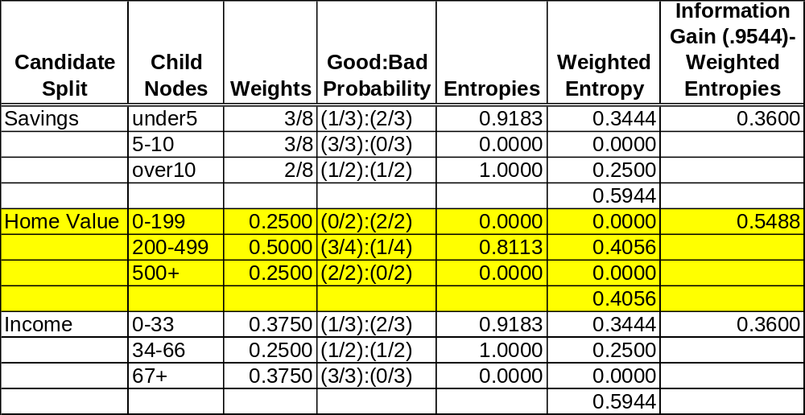
Information Gain (First Iteration)
So we will split on home value:0-199 will go to bad, 500+ will go to good, and we will have to make a new table for 200-499

Slide 21
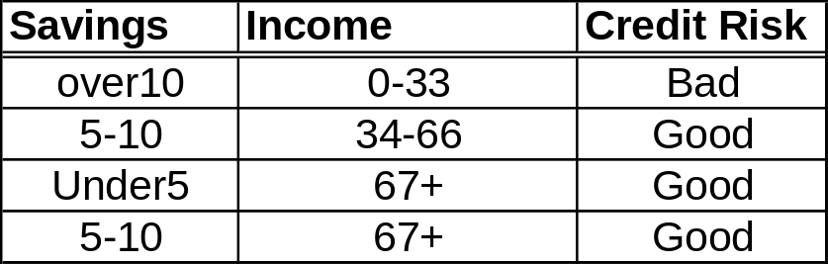
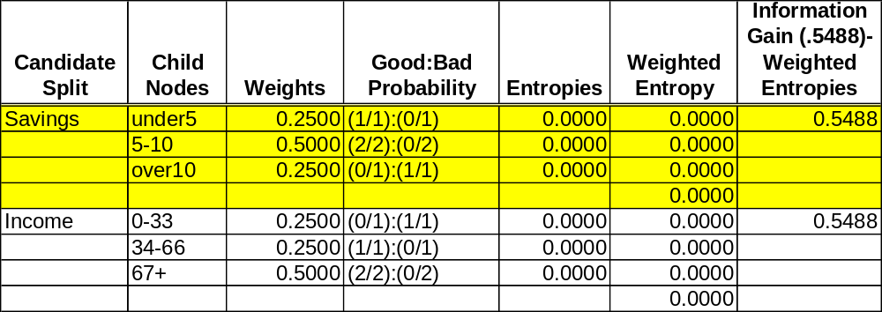
Second iteration

Slide 22
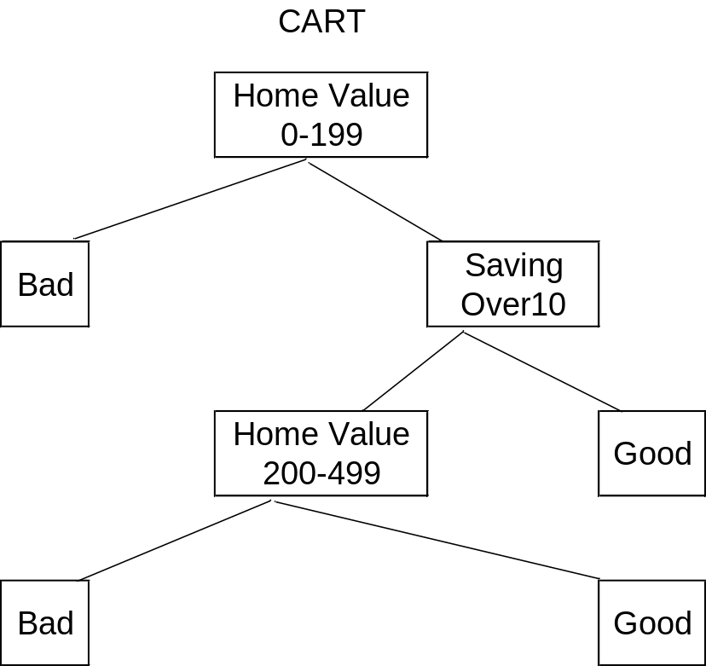
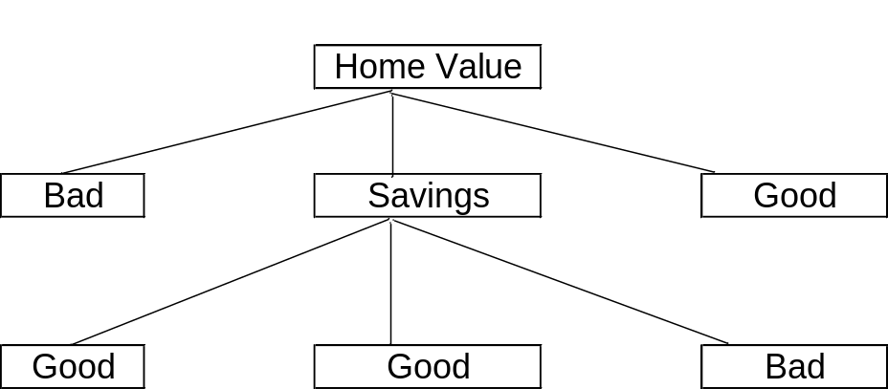
Tree Comparison
Convince yourself that if we create an if-then-else rule set, that both trees give the same rules for credit risk

Slide 23
A Couple of things to Notice
Both trees give human readable results. It’s fairly easy to imagine how a loan officer can walk a customer through a loan approval or rejection
It’s also easy to program a computer to read through a tree and find a target via if-then-else statements
The C4.5 tree looks simpler, but it wouldn’t be if we had a dozen choices for each asset class

Slide 24
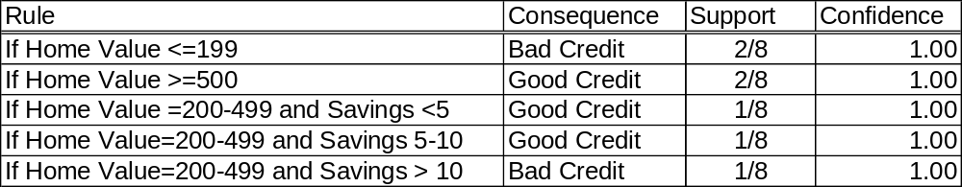
Decision Rules Derived from C4.5 Tree
Note in our simple example the tree is pure
In more complex examples the confidence values might be less than 1.0

Slide 25
Tree Pruning
Decision Trees are susceptible to over-fitting so setting aside some data for testing is crucial
They are also susceptible to repetition (that is, an attribute being tested over and over again in different branches)
Tree pruning can help with both problems
By using data outside the training set an error rate can be computed for any subtree above a leaf node
We can also compute complexity of each computation ending at a leaf node
We won’t talk about pruning tonight but there are algorithms that prune trees based on complexity as well as error rates (The interested reader can see Larose for algorithms)

Slide 26
Repeat Both Examples in R

Slide 27
Data Set Used for R Example
Adult data set from UCI Machine Learning Repository https://archive.ics.uci.edu/ml/datasets/Adult
Data Extracted from 1994 Census. Target variable does personal income exceed $50k in 1994
Created by Ronny Kohavi and Barry Becker
Silicon Graphics Inc.
32,561 records, 14 Attributes

